Slide 1

Exploratory Data Analysis
G2M insights for cab investment firm
20 June 2022
By : Trusti Patel

Slide 2

Agenda
Problem Statement
Data Information
EDA
EDA Summary
Recommendations

Slide 3
Problem Statement:
XYZ is the US firm who wants to invest in Cab company. However, they wants to do some market research on different cab companies.
Goal :
The purpose here is to provide XYZ company with some insights based on data provided. So, they can invest in best company and make profit out of it.

Slide 4
Data Information
We have been provided with 4 individual data sets.
Cab_Data.csv – this file includes details of transaction for 2 cab companies
Customer_ID.csv – this is a mapping table that contains a unique identifier which links the customer’s demographic details
Transaction_ID.csv – this is a mapping table that contains transaction to customer mapping and payment mode
City.csv – this file contains list of US cities, their population and number of cab users

Slide 5
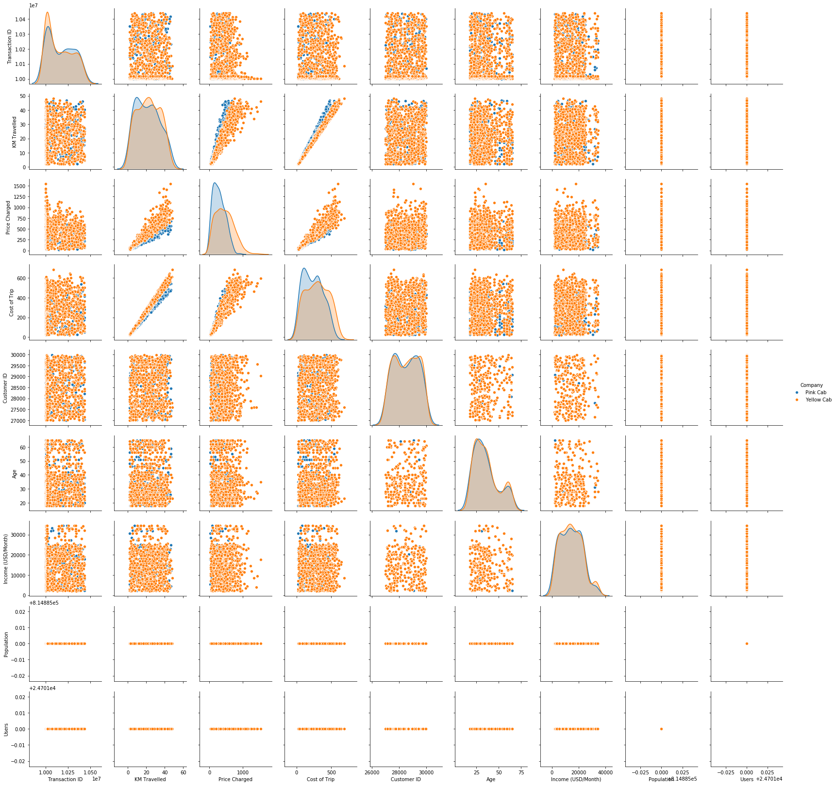
Relation among variables:
[ Heat-map for all the variables ]

Slide 6
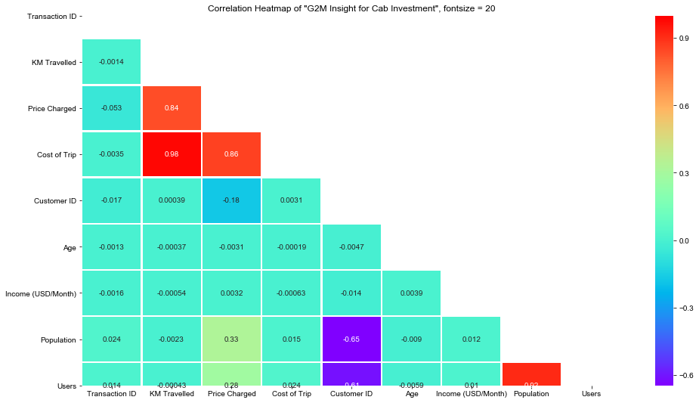
Correlation
Observation :
Based on Heat-map results we can see that the (Km Travelled & Cost of Trip, Population & Users) have the highest correlation.

Slide 7
EDA

Slide 8
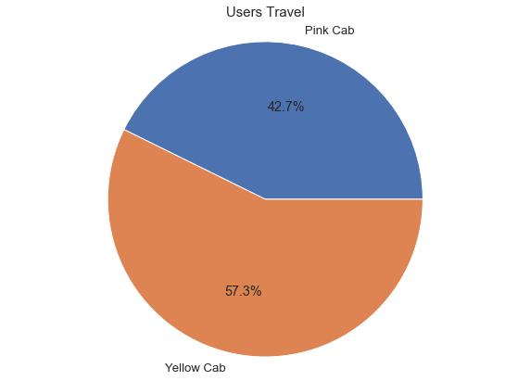
Average Users for each cab company
Observation :
From the above Pie chart we can see the usage of 'Yellow Cab' is higher that the 'Pink cab'.

Slide 9
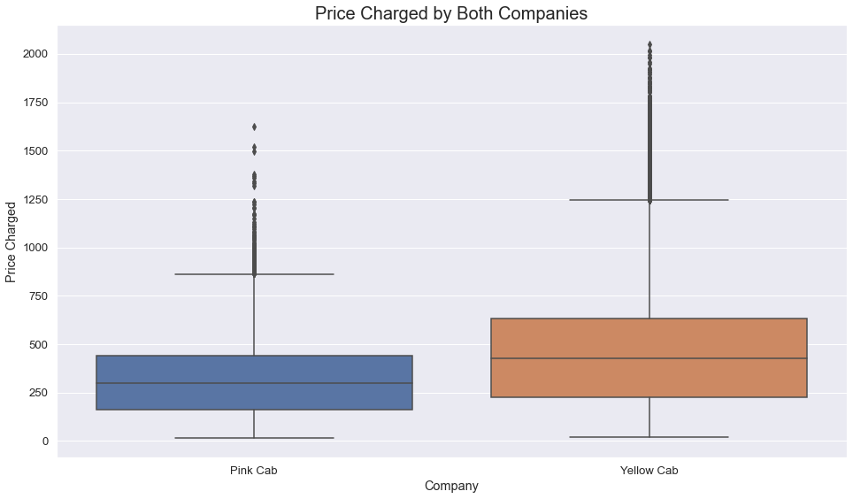
Price charged by both company
Observation :
As we can see that Price changed by Yellow cab is higher than the other cab company, yet yellow cab has higher users than pink cab.

Slide 10
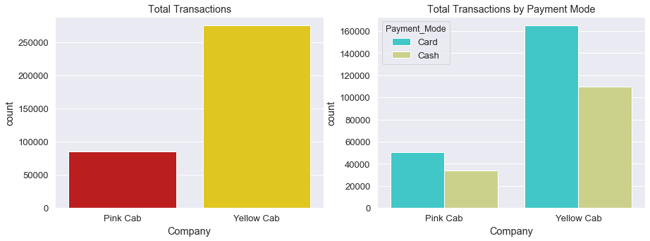
Payment transaction and mode
Observation :
Based on the above results, we can see that total transaction between two companies have huge margin gap, as well as payment method also varies for both the companies. Also most of the yellow cab users pays by card.

Slide 11
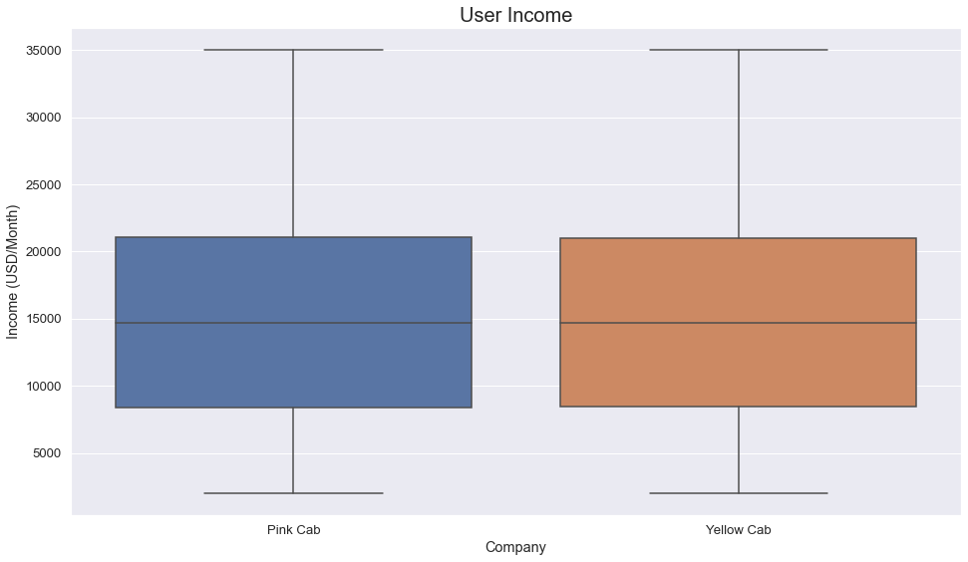
Cab users and their income
Observation :
As we can see, people with income of (8000 - 21000) USD/Month are using cab. And there is not much impact on both cab companies based on income.

Slide 12
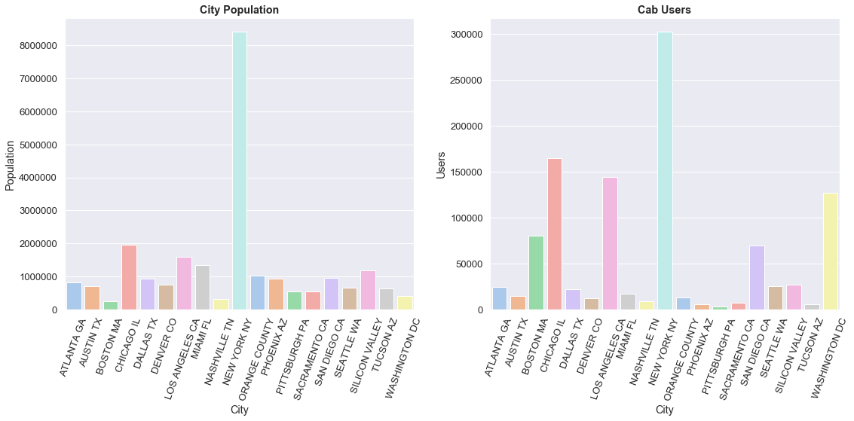
Cab users vs. Population
Observation :
From above bat plot it is clear that higher population has higher cab users. Based on that New York, Chicago followed by Los Angeles have highest cab users. So, investing in these cities can be more profitable.

Slide 13
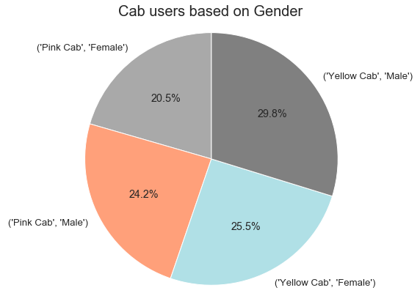
Cab users and their gender
Observation :
We can notice two things here: firstly, Male uses more cab than Female and they prefer to travel in Yellow cab.

Slide 14
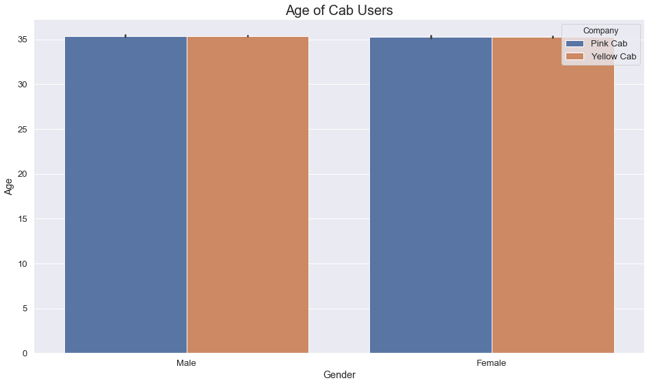
Cab users their and Age
Observation :
As we see Female and Male of average of 35 use a cab service.

Slide 15
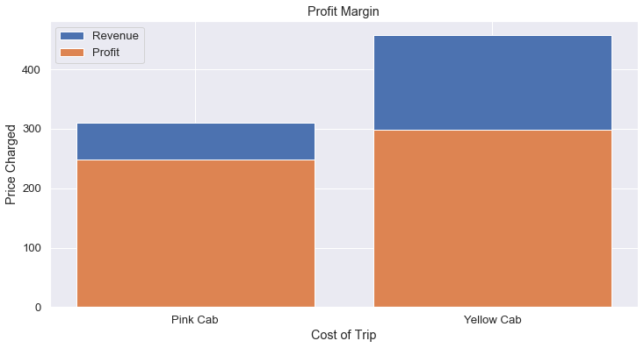
Profit Margin of Cab companies
Observation :
As we see Yellow Cab has a higher Profit Margin than Pink Cab.

Slide 16
Recommendation:
To conclude, Based on all the data and diagrams, my suggestion to XYZ firm is to go with Yellow Cab for investment. It has more potential to make profit.

Slide 17
Thank You…!!

